Slide 1
S78 polarity checks during injection test 24.08.2008 8:07-10:00 (on momentum) 19:20-21:05 (off momentum)
Rama Calaga, Verena Kain, Mike Lamont,
Laurette Ponce, Rogelio Tomas,
Frank Zimmermann

Slide 2
conditions
low intensity 2x10⁹
net momentum offset Δp/p~+2.6x10⁻³,
4-5 x larger than for S23!
kicks 20 μrad (morning) – 2x larger than S23
40 μrad (evening) – 4 x larger than S23
help from Rama, Rogelio, Laurette
sufficient time kindly granted by Brennan
analysis ongoing (slowed down by SPS MDs)

Slide 3
polarity checks
Basic procedure:
launch betatron oscillations with single orbit corrector
change strength or polarity of circuit under investigation, and take four orbits: oscillation for new strength , oscillation for old strength , reference orbit new strength, reference orbit old strength
for sextupole circuits change momentum offset of injected beam
data taken for following S78 beam-2 circuits:
RSD1&2, RSF1&2, MCS, MSS (soff-momentum)
QTL11L8, QT12L8, QT13RL8
MQS
OD, OF (on and off-momentum)

Slide 4
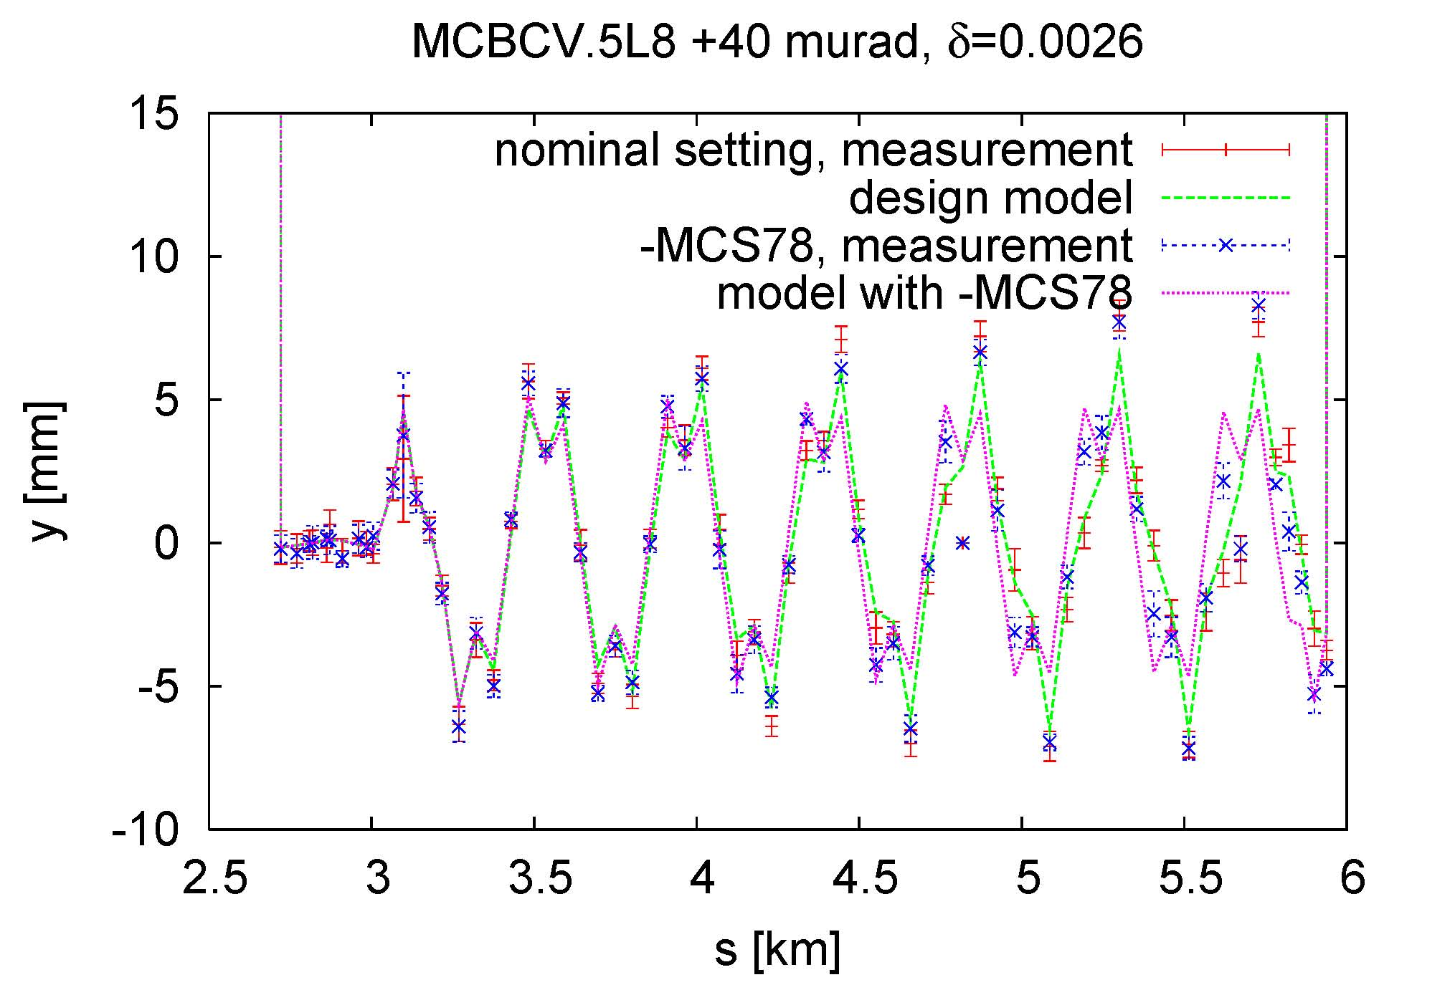
both signs of b3 spool pieces

Slide 5
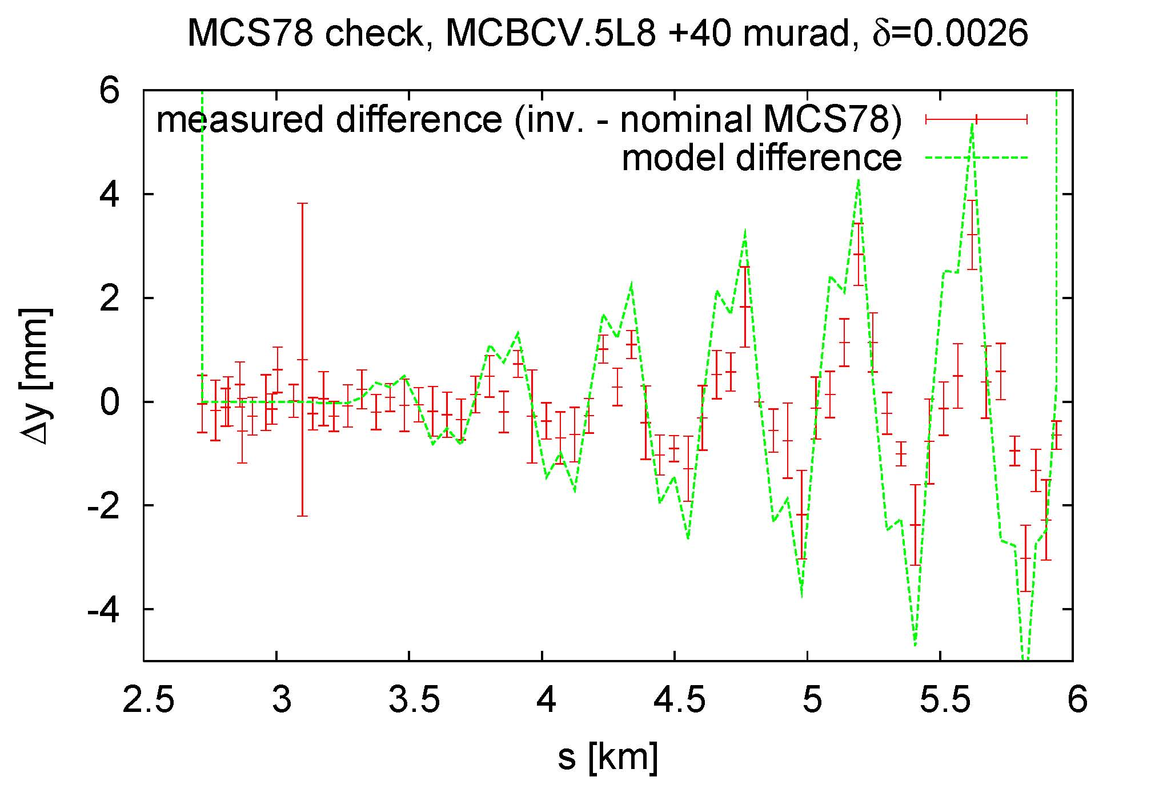
plot difference to reveal effect of b3 spool pieces
excellent agreement with model → MCS correct sign & strength

Slide 6
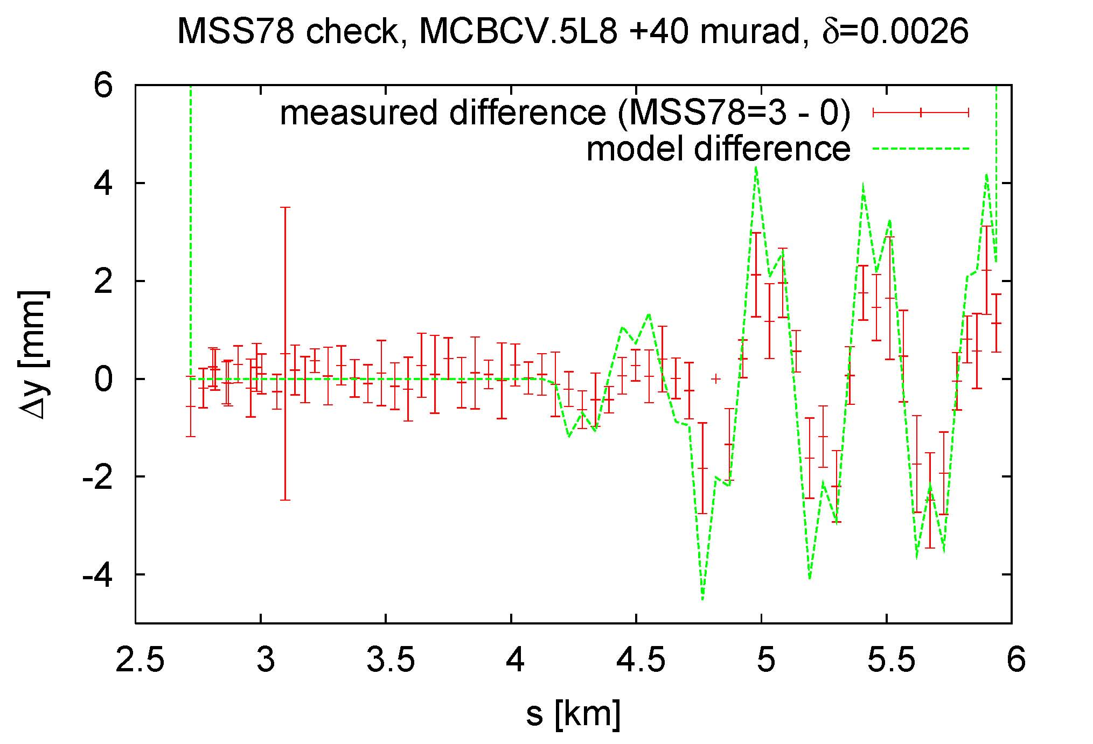
effect of skew sextupoles
excellent agreement with model → MSS correct sign & strength

Slide 7
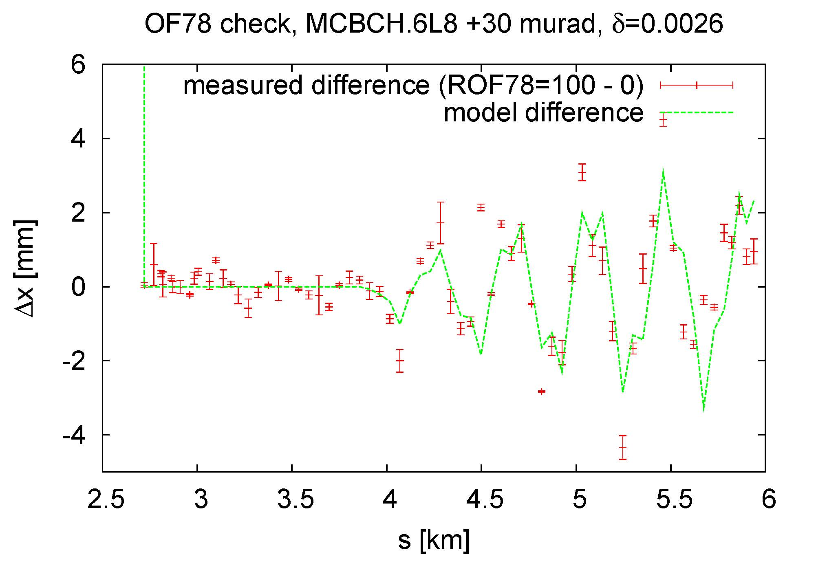
effect of OF Landau octupoles
slightly worse agreement with model towards the end -
beam scraping, noise or some problem in x?

Slide 8
preliminary conclusions
see clear effect of OD, OF, MSS, MCS, SF, SD circuits
excellent agreement between measurement and expectation for MCS, MSS and OF → correct sign & strength
… data analysis still ongoing

